Slide 1

Expense Management System
SHARAD KUMAR MISHRA
PRANTA SAHA
ANIL KUMAR REDDY
OMKAR KHANAI
VAISHNAVI
BINDU SRIJA
B
A
T
C
H
1

Slide 2
Abstract
The Expense Management System (EMS) is a comprehensive web application designed to help organizations streamline the process of tracking, managing, and reporting expenses efficiently. Developed as part of an Infosys Springboard internship, the project utilizes the MERN stack (MongoDB, Express.js, React.js, Node.js) and a monolithic architecture to ensure scalability, flexibility, and ease of maintenance.
The EMS is structured into several key modules:
User & Admin Module (BINDU SRIJA): Facilitates user and admin registration, authentication, and role-based access control.
Expense Module (SHARAD KUMAR MISHRA): Allows users to log, edit, and categorize their expenses, ensuring real-time tracking.
Category Module (PRANTA SAHA): Classifies expenses into predefined categories, simplifying budgeting and financial management.
Report Module (VAISHNAVI): Generates detailed expense reports for users and admins, with alerts and email notifications.
Notification Module (OMKAR KHANAI): Provide users with in-app notifications and feedback capabilities, ensuring transparency and user interaction.

Slide 3
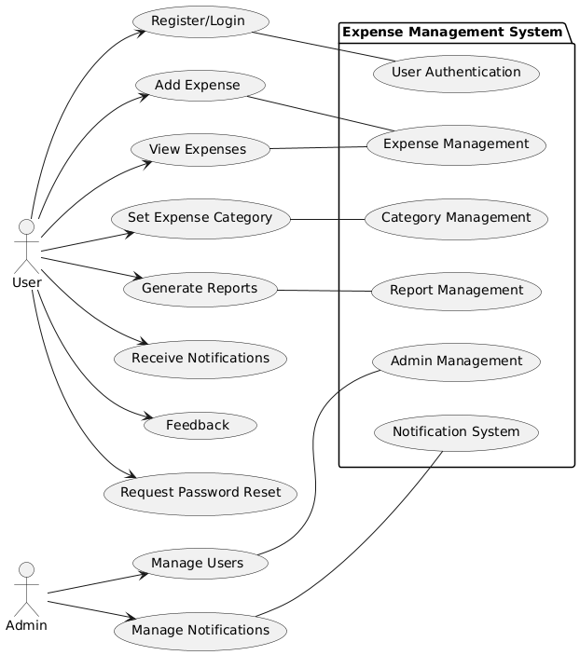
Use Case Diagram

Slide 4
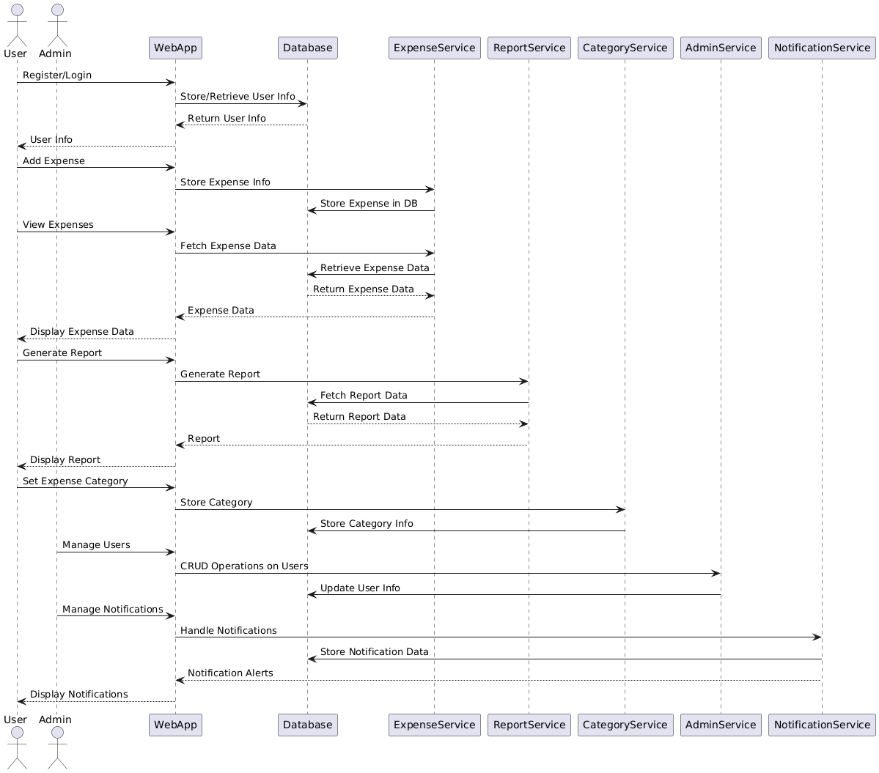
Sequence Diagram

Slide 5
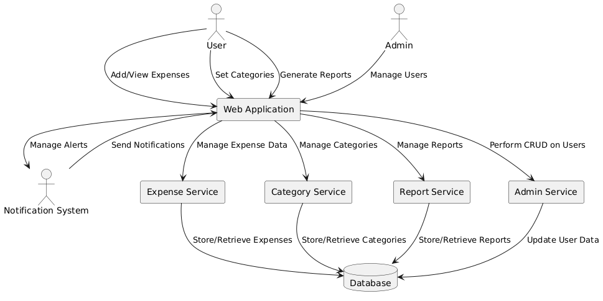
Data Flow Diagram(DFD)

Slide 6

Expense Management System: User-Friendly Financial Tracking

Slide 7
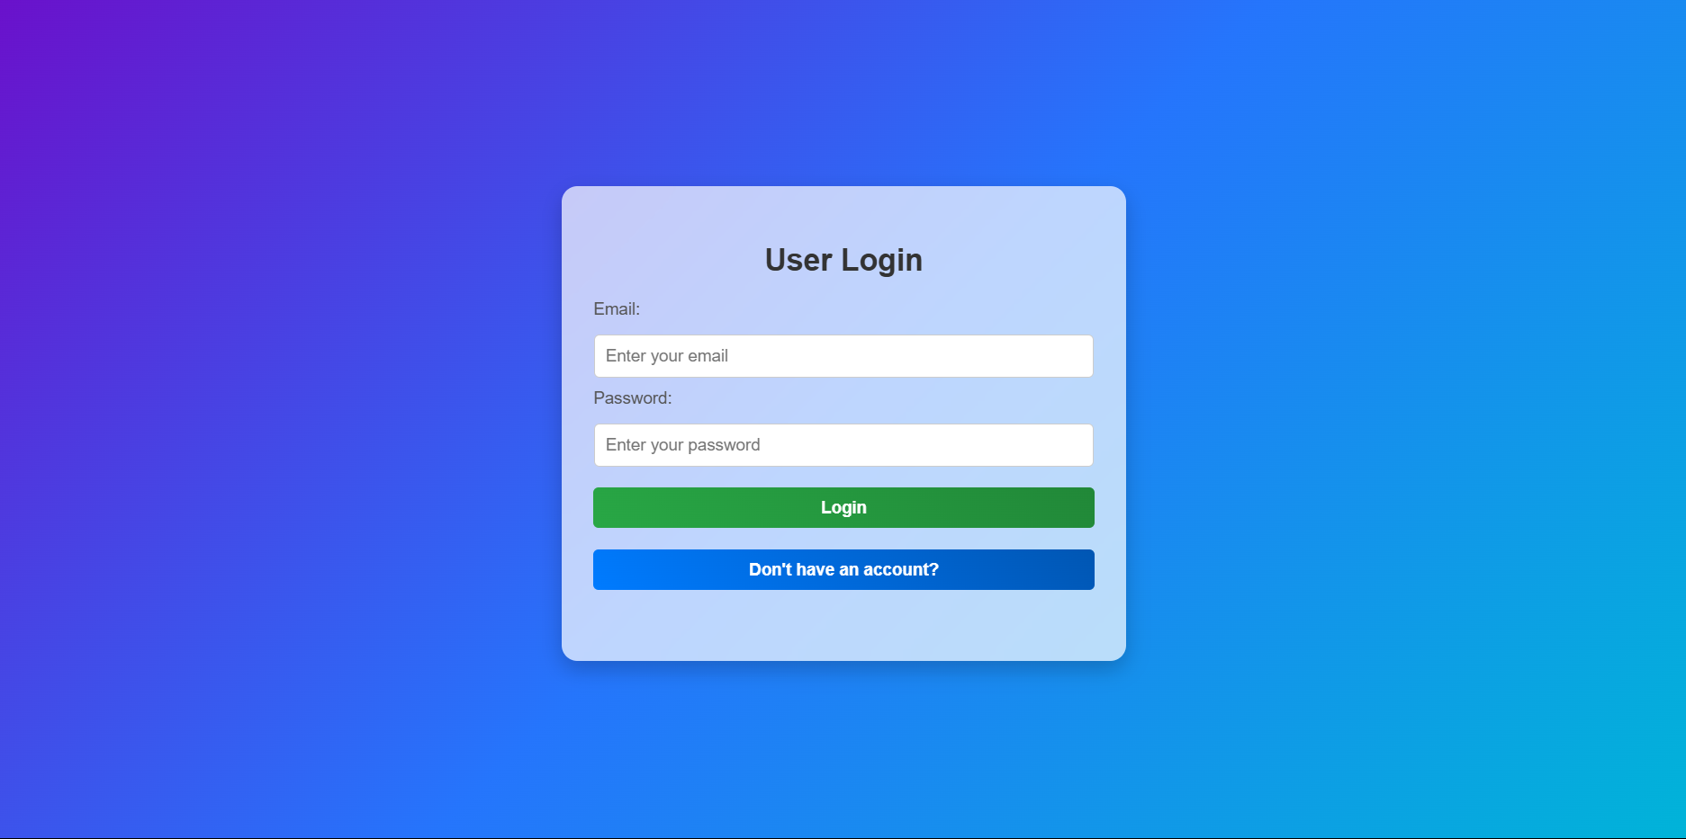
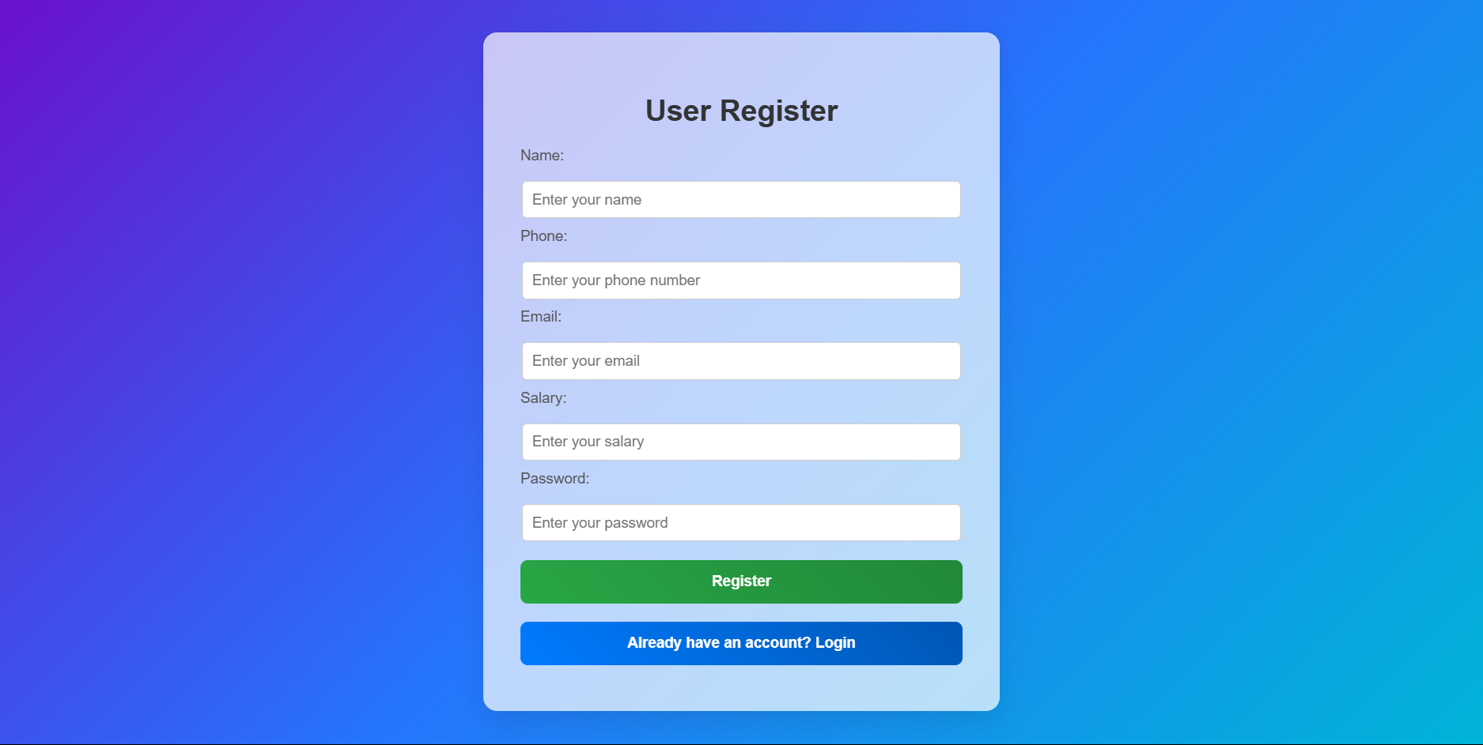
User Login & Register

Slide 8
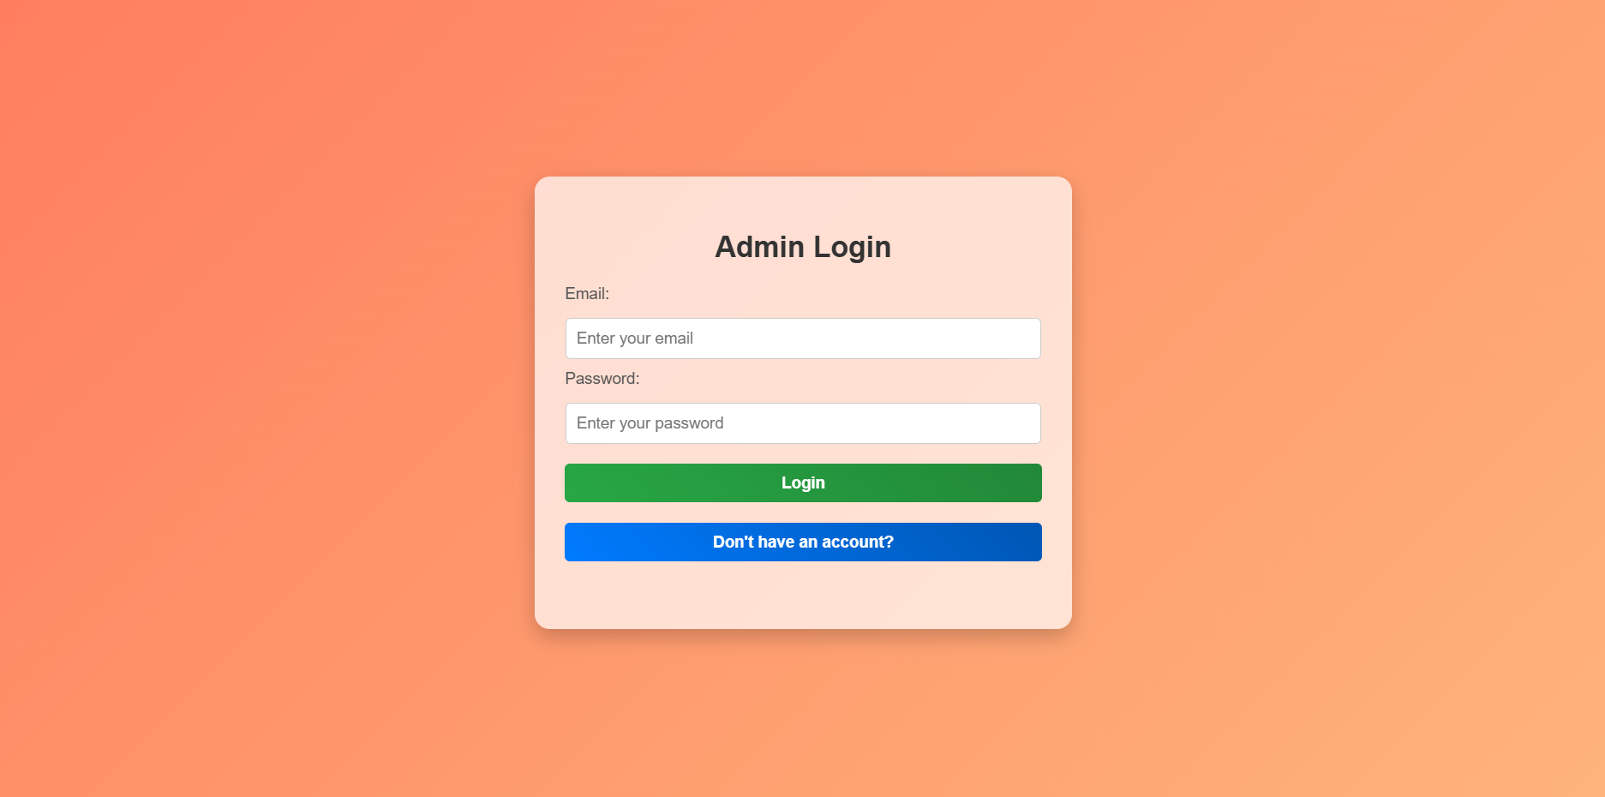
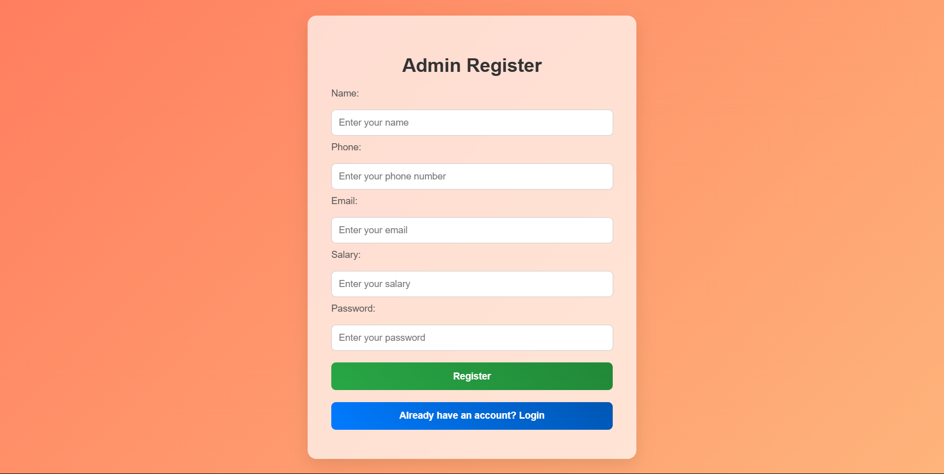
Admin Login & Register

Slide 9
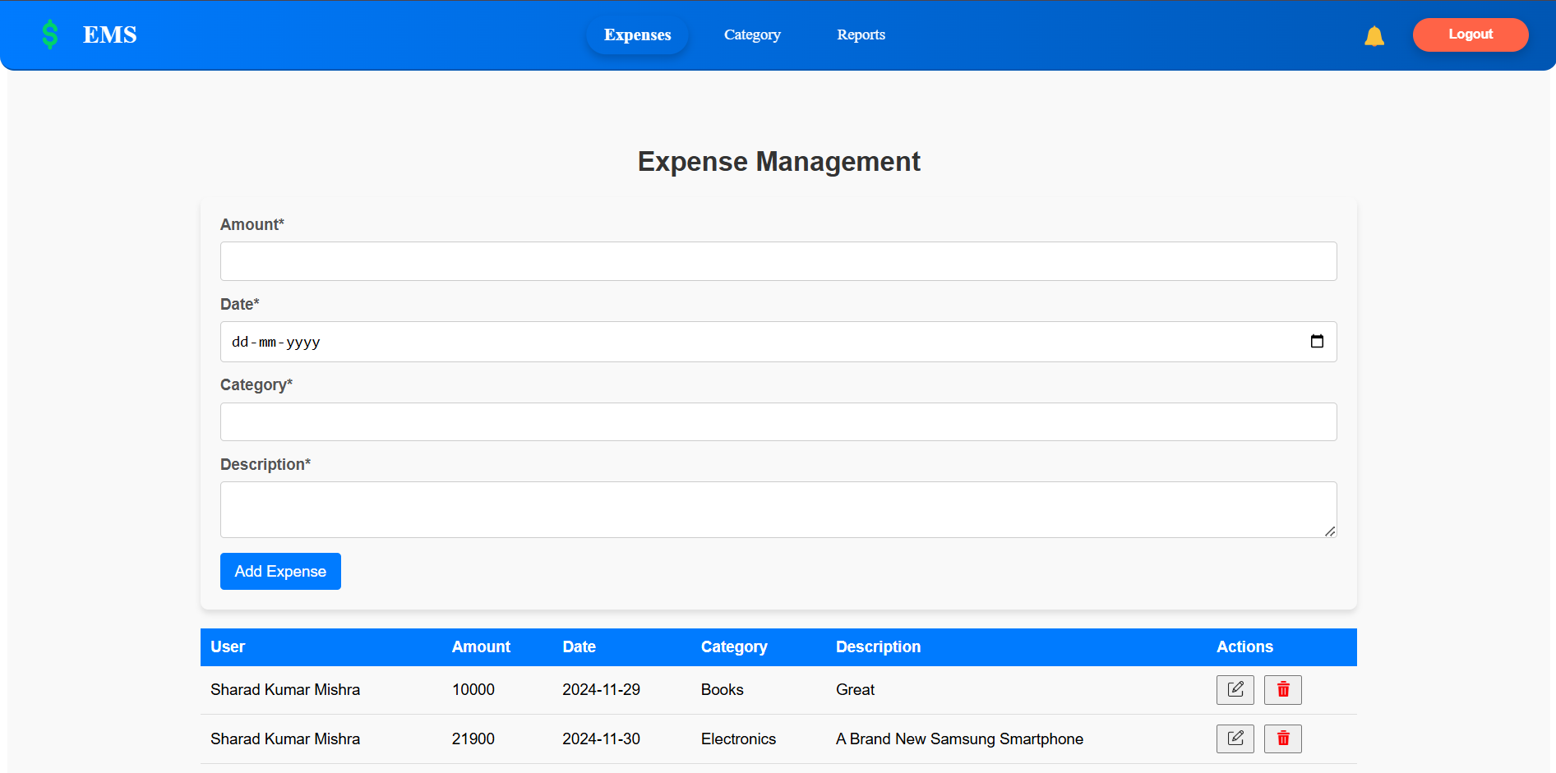
Expense Module

Slide 10
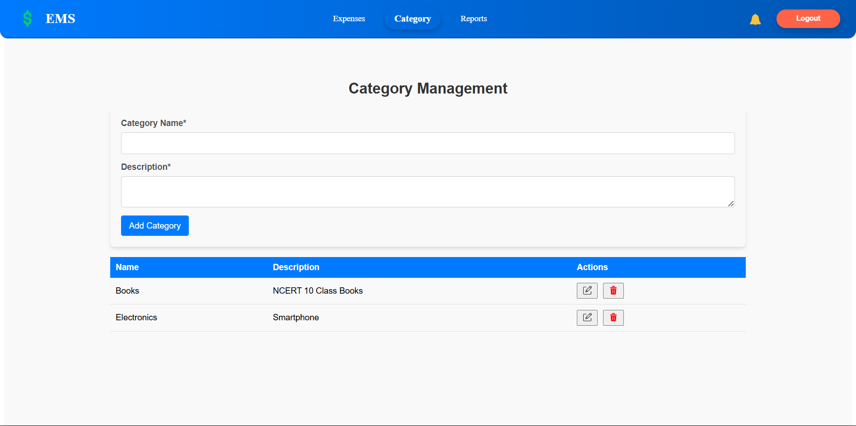
Category Module

Slide 11
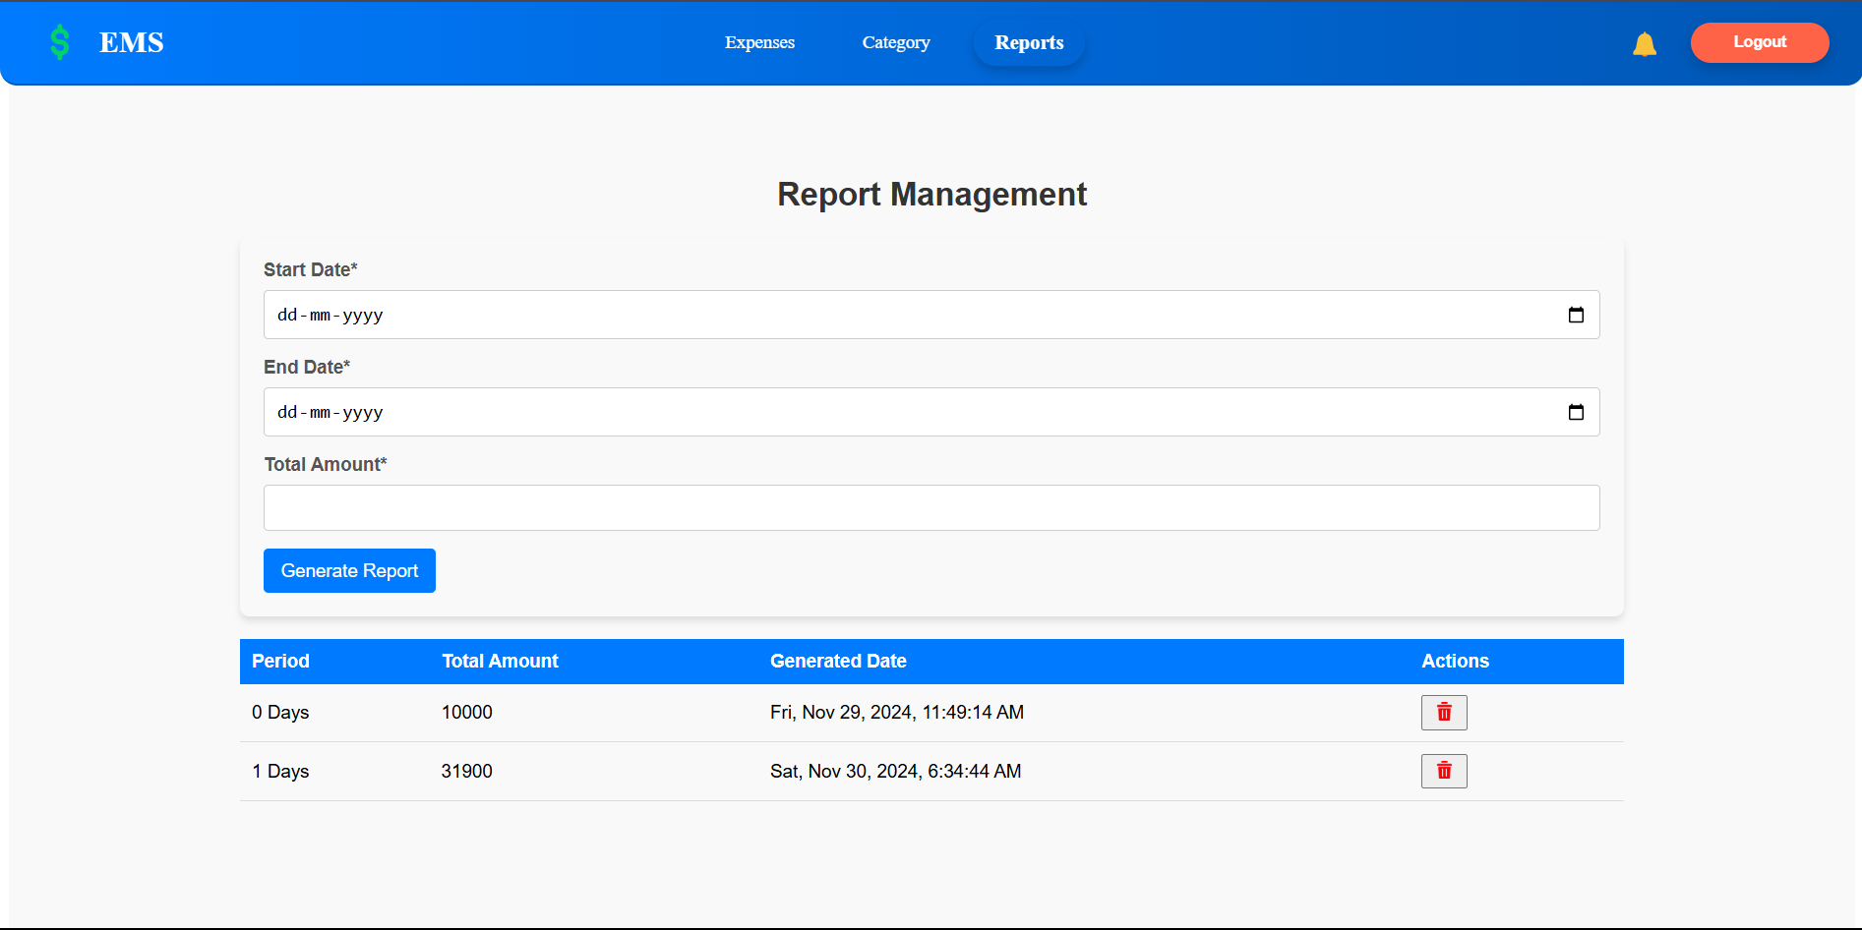
Report Module

Slide 12
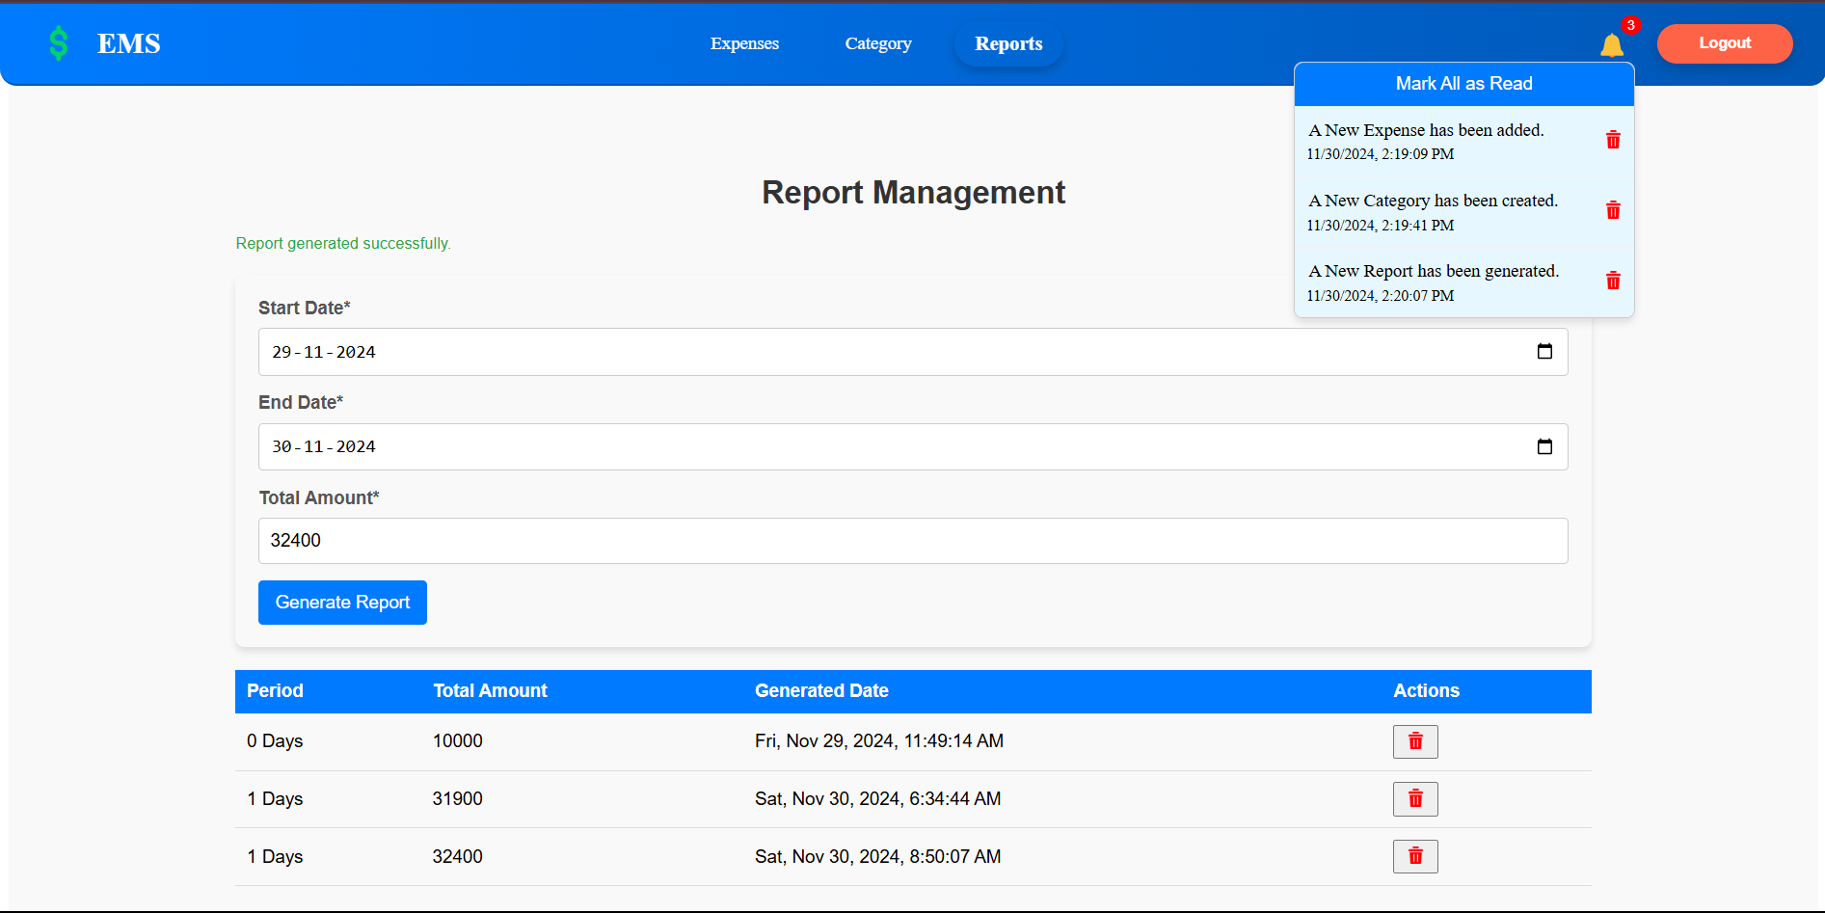
Notification Module

Slide 13
Features Enhancement
Role-Based Dashboards: Personalized user and admin dashboards, offering specific insights and tools tailored to their roles.
Real-Time Expense Tracking: Live updates for tracking expenses, allowing users to log, edit, and categorize expenses instantly.
Advanced Notification System: In-app notifications and email alerts for reminders, approvals, and system updates.
Expense Categorization: Simplified budgeting with categorized expenses for better financial planning and insights.
User-Friendly Interface: Intuitive and responsive design for easy navigation and smooth user experience.

Slide 14
Conclusion
The EMS provides a scalable and efficient solution for managing and tracking expenses, reducing manual effort.
Modern technologies like React.js, Node.js, and MongoDB ensure flexibility, scalability, and seamless integration of the system.
The system improves transparency and ensures adherence to corporate standards and tax laws, benefiting both users and administrators.
Key modules such as user authentication, expense categorization, report generation, and in-app notifications streamline the expense management process.
The implementation of role-based dashboards and real-time alerts enhances the user experience and increases administrative efficiency.
By automating expense tracking, the EMS enables businesses to focus on strategic financial planning and reporting, adding significant business value.
The project demonstrates high adaptability for real-world business environments, making it a reliable tool for streamlining financial operations.

